Slide 1

IBM Data Science Professional Certificate – Final Capstone Project :
Analysing Restaurants Data in Toronto City
Submitted by :
Bharat Bhushan

Slide 2
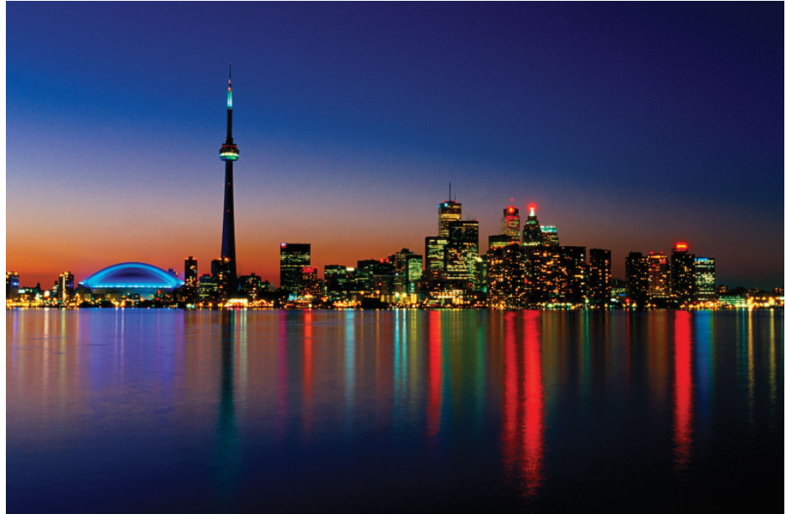
Introduction
- Toronto is one of the most populous cities in Canada and home to a diverse population.
- In this presentation, I plan to discuss about my project where I explored restaurants in neighbourhoods of Canada to come up with recommendations for a person who plans to open a new restaurant.

Slide 3
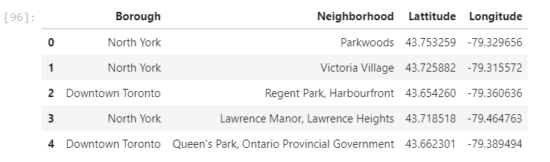
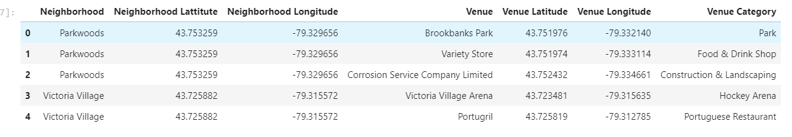
Data Collection and Cleaning
Collect information on different neighborhoods in Toronto from wiki page : Toronto Postal Codes.
2. Use Foursquare API to find different venues available on all neighborhoods.

Slide 4
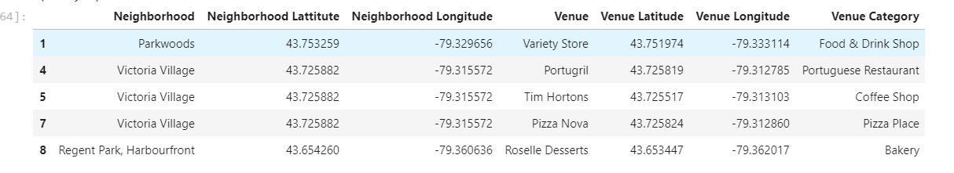
Data collection and cleaning [contd]
Data is then cleaned to get a list of restaurants and their categories in city of Toronto.
It gave 1070 samples.

Slide 5
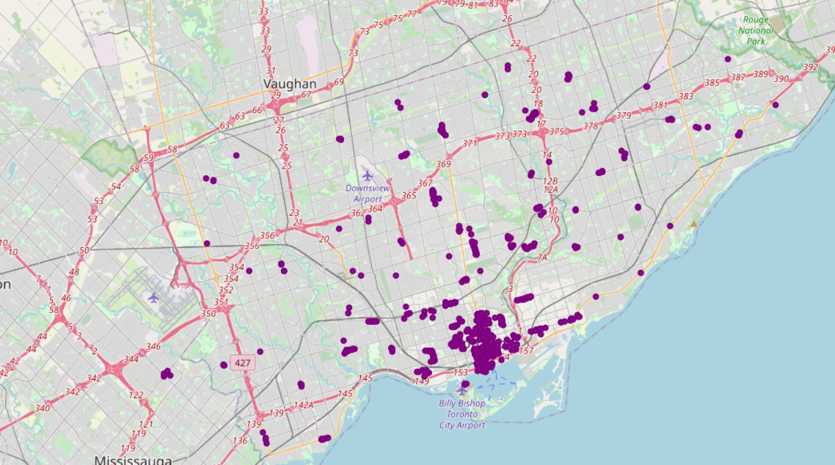
EDA :Map showing all the restaurants in Toronto

Slide 6
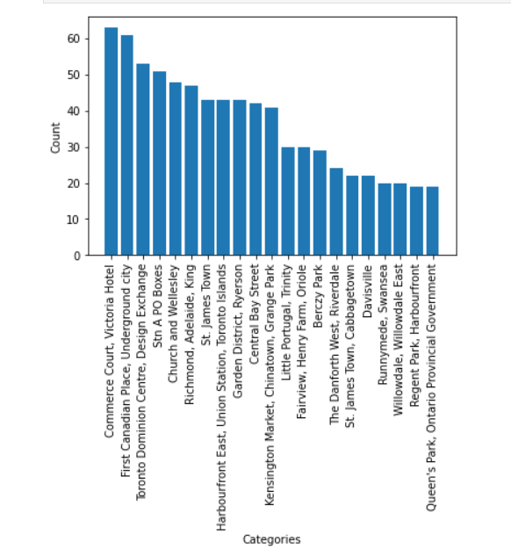
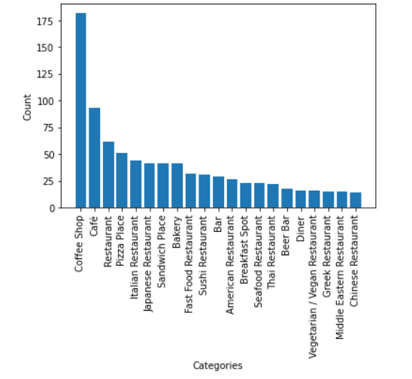
EDA - Data visualizations :
Categories of restaurants
Restaurants in different neighbourhoods

Slide 7
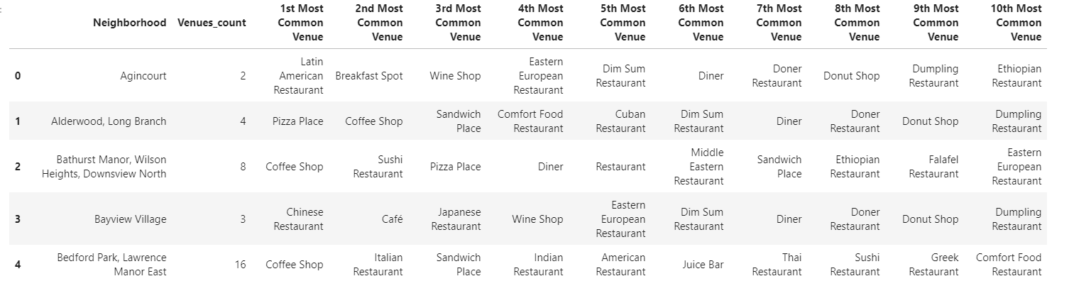
EDA - Top 10 most common categories in each neighbourhood

Slide 8
EDA – key takeaways :
Neighbourhoods in borough Downtown have highest number of restaurants.
Coffee shop is the most common category of restaurants.
There are restaurants of different cuisines and distribution is almost similar.

Slide 9
Feature Selection
Restaurant categories in each neighbourhood is used as feature after converting it to numeric data using one hot encoding.
Number of restaurant in each neighbourhood is used as another feature.
Model generation
K-means clustering is used to divide the data into 2 groups.
Group1 has 68 neighbourhoods and Group2 has 13 neighbourhoods.

Slide 10
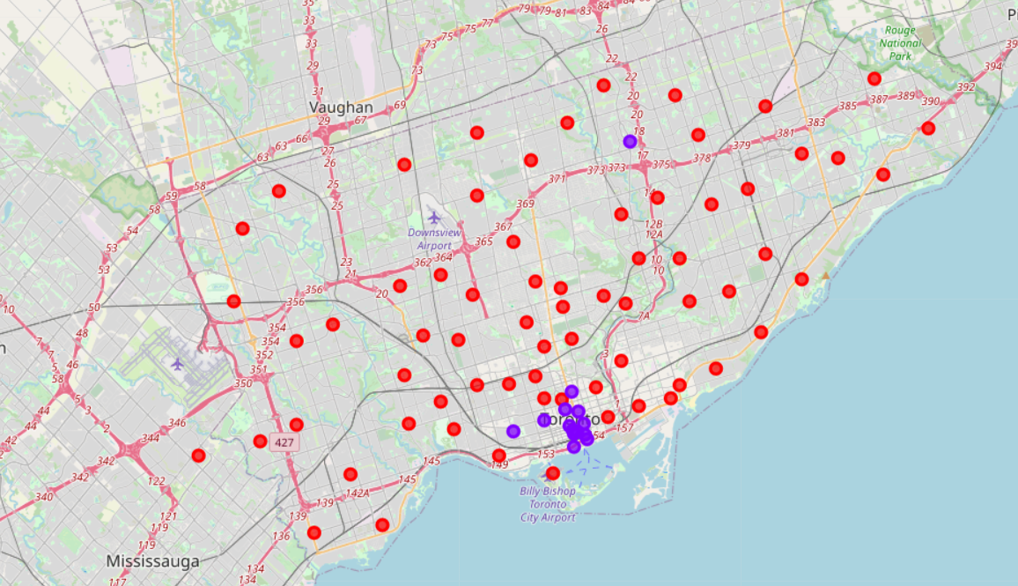
Results and Discussions :
Data is divided into 2 clusters.
Map showing neighbourhoods in different clusters in different groups.

Slide 11
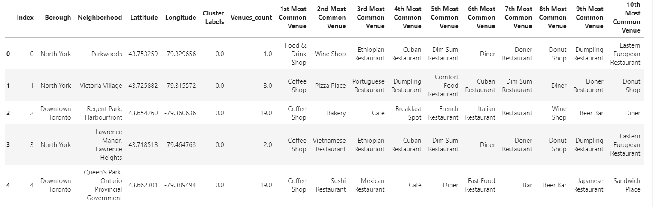
Results and discussions
Cluster 1 has 68 neighbourhoods.
Neighbourhoods in this cluster have lesser number of restaurants.
Ist 5 neighbourhoods in this cluster :

Slide 12
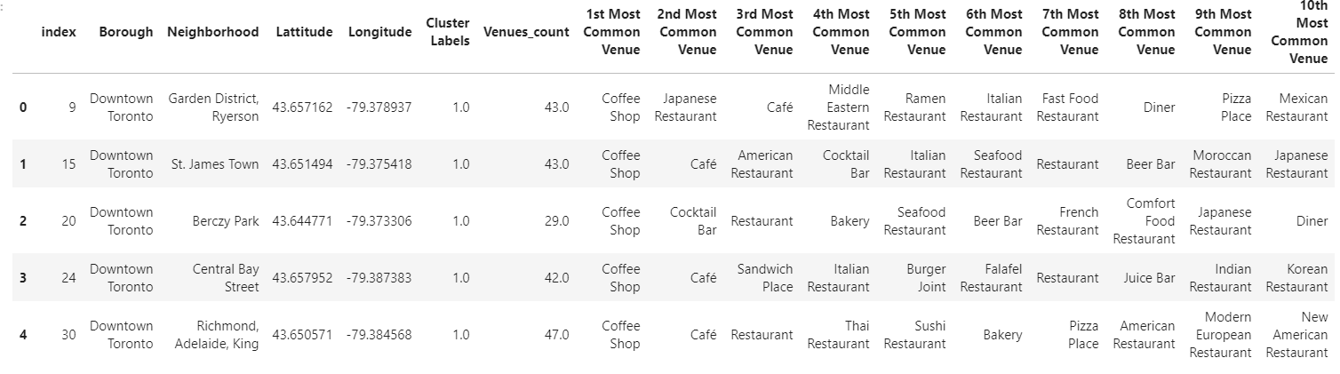
Results and discussions
Cluster 2 has 13 neighbourhoods.
Neighbourhoods in this cluster have good number of diverse categories of restaurants.
Most of these neighbourhood belong to Downtowm borough.
Ist 5 neighbourhoods in this cluster :

Slide 13
Conclusion
Analysed different neighbourhoods in Toronto based on number of restaurants and categories.
List of neighbourhoods is divided into two sets.
List of neighbourhoods is dumped in an excel file.

Slide 14
Thank You!!

